Slide 1
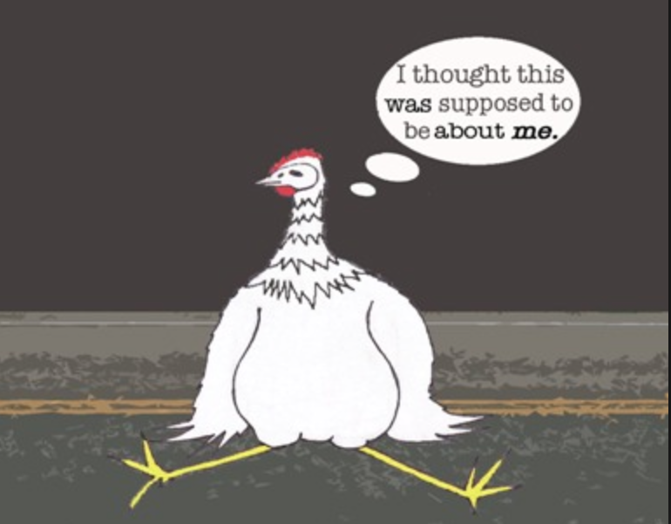
Why was the road crossed
by the chicken?
Voice
Gayle Moran, Ph.D.

Slide 2
Professional engineers say:
“Engineering reports present our subjective opinions and recommendations based on objective information. We need to be clear about who performed the action. Often the biggest challenge to clear writing is passive voice.”
Portland State University, Civil Engineering Writing Project, 2015.

Slide 3
“Nature journals prefer authors to write in the active voice ("we performed the experiment...") as experience has shown that readers find concepts and results to be conveyed more clearly if written directly.”
“Write in the active and use the first person where necessary.”

Slide 4
“The use of first-person pronouns (I, we, my, our) should be avoided in technical material. The use of “the authors” or “this researcher” is preferred to first-person pronouns.
“Authors should use first-person pronouns only if absolutely necessary to avoid awkward sentence construction.”
“If you wish, you may write in the first person singular or plural and use the active voice (‘I observed that …’ or ‘We observed that …’ instead of ‘It was observed that …’).”

Slide 5
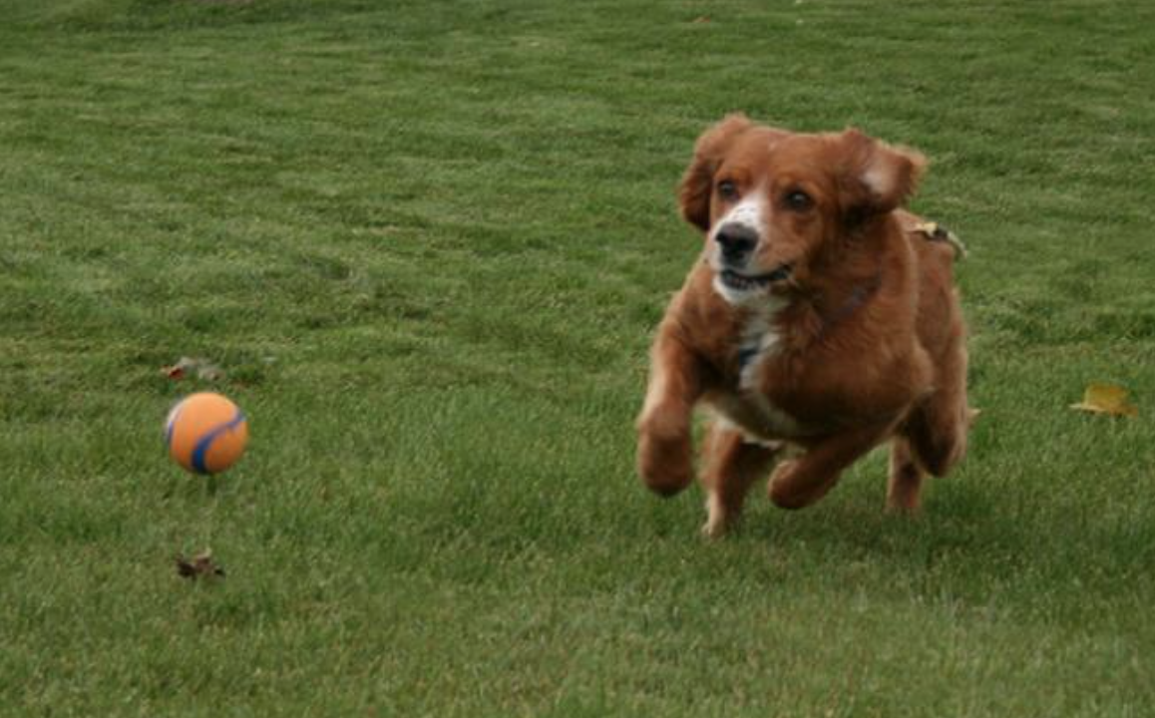
The dog
chased
the ball.

Slide 6
The ball
was chased
by the dog.

Slide 7
The ball
was chased.

Slide 8
Passive Voice | Active Voice
Longer sentences | Shorter sentences
Sounds impersonal | Sounds more engaging
Leads to ambiguous actors | Makes actors clear
Weak language | Confident language
Less clear and direct | Clearer and more direct
Construction can be confusing for readers | Easier for readers to follow Better reader retention

Slide 9
Subject Position
Tariq measured the temperature.
Subject Position
The temperature was measured by Tariq.

Slide 10
Active or Passive Voice?
Identify the topic you are discussing and place it in the subject position.
The preprocessor sorts the two arrays.
The two arrays are sorted by the preprocessor.

Slide 11
When do I use passive voice?
The cave paintings of Lascaux were made in the Upper Old Stone Age.
The actor is unknown.
An experimental solar power plant will be built in the Australian desert.
The actor is irrelevant.
You want to be vague about who is responsible.
Mistakes were made.

Slide 12
When do I use passive voice?
You are talking about a general truth.
Rules are made to be broken.
You want to emphasize the person or thing acted on.
Insulin was first discovered in 1921 by researchers at the University of Toronto.
You are writing in a genre that traditionally relies on passive voice.
The sodium hydroxide was dissolved in water. This solution was then titrated with hydrochloric acid.

Slide 13
When do I avoid passive voice?
When too many passive sentences can create confusion.
Research has been done to discredit this theory.
To hide holes in your research.
The telephone was invented in the nineteenth century.
When your writing is starting to sound wordy and indirect.
Since the car was being driven by Michael at the time of the accident, the damages should be paid for by him.

Slide 14
Find your passive sentences
To spot passive sentences, look for a form of the verb “to be” in your sentence, with the actor either missing or introduced after the verb using the word “by.”
be, am, is, are, being, was, were, been
Genetic information is encoded by DNA.
DNA encodes genetic information.

Slide 15
The temperature is believed to be the cause for…
Who believes this?
Biologists believe the temperature to be …
The authors believe the temperature to be …
We believe the temperature to be …

Slide 16
Weak Passive | Better Passive | Active
Ion sampling from the plasma was achieved. | The ions from the plasma were sampled. | We sampled the ions from the plasma.
Removal of the coating was effected by the application of alcohol. | The coating was removed with alcohol. | I removed the coating with alcohol.
Regular inspections of the burners were not carried out. | The burners were not inspected regularly. | We did not inspect the burners regularly.

Slide 17
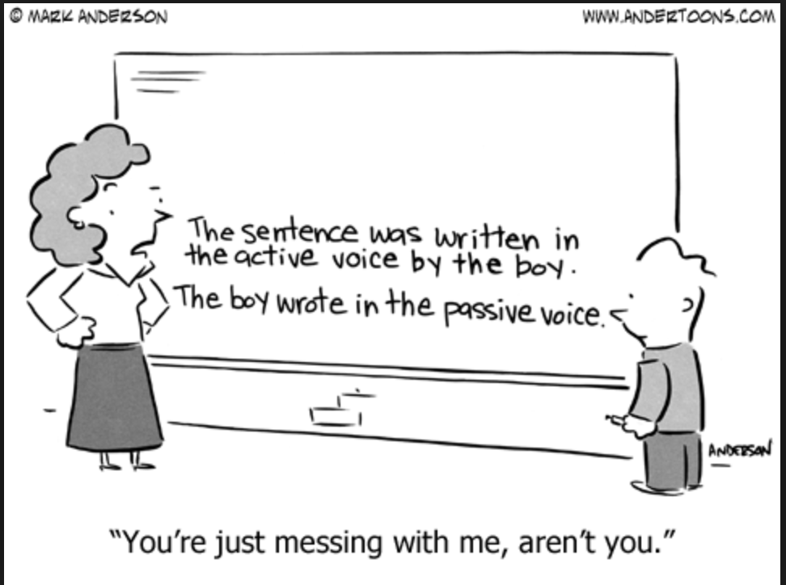

Slide 18
Who (or what) is the sentence about?
What is she/he/it doing?
Use strong, precise verbs.

Slide 19
We held a meeting to give consideration to the proposal.
Weak verbs dilute your writing.
Strong verbs say more in less time.
We met to consider the proposal.

Slide 20
13 words
The engineering managers made the decision to give their approval to the plan.
8 words
The engineering managers decided to approve the plan.
11 words
We need to perform a periodic review of the circuit design.
8 words
We need to review the circuit design periodically.

Slide 21
Put Actions in Verbs
Action | Nominalization
Regulate | Regulation
Analyze | Analysis
Occur | Occurrence
Discover | Discovery
Investigate | Investigation
Perform | Performance
Fail | Failure
Resist | Resistance
A nominalization is a verb (or adjective) that has been turned into a noun.

Slide 22
Action
Nominalization
We performed an analysis on the data.
Action
We analyzed the data.

Slide 23
There was considerable erosion of the land from the floods.
When a nominalization follows a “there is” or “there are,” change the nominalization into a verb and find the subject.
The floods considerably eroded the land.

Slide 24
The engineering managers made the decision to give their approval to the plan.
The engineering managers decided to approve the plan.
We need to perform a periodic review of the circuit design.
We need to review the circuit design periodically.

Slide 25
We have characterized the role of protein X in signaling pathway Y.
Our results elucidate a mechanism for protein X’s involvement in membrane trafficking.
This paper establishes a new paradigm for the effect of protein X in the context of disease Z.
Protein X has a role, is involved, and has some kind of effect.
We have no idea what protein X is actually doing.

Slide 26
We have characterized the role of protein X in signaling pathway Y.
activates
We demonstrate that protein X activates signaling pathway Y.
Our results elucidate a mechanism for protein X’s involvement in membrane trafficking.
initiates
Our results show that protein X initiates a phosphorylation cascade that is required for membrane trafficking.
This paper establishes a new paradigm for the effect of protein X in the context of disease Z.
This paper establishes that point mutations in protein X cause aberrant cell-cell contacts, causing disease Z.
cause

